Slide 1
Diagrams

Slide 2
Low Level Diagram

Slide 3
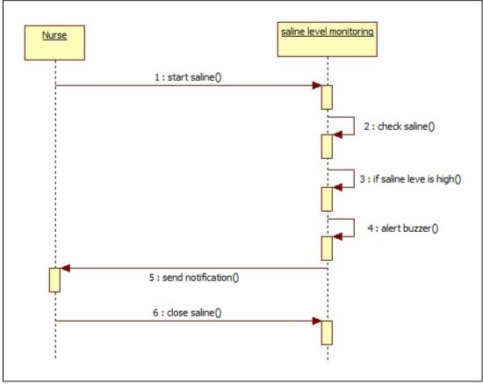
Sequence Diagram

Slide 4
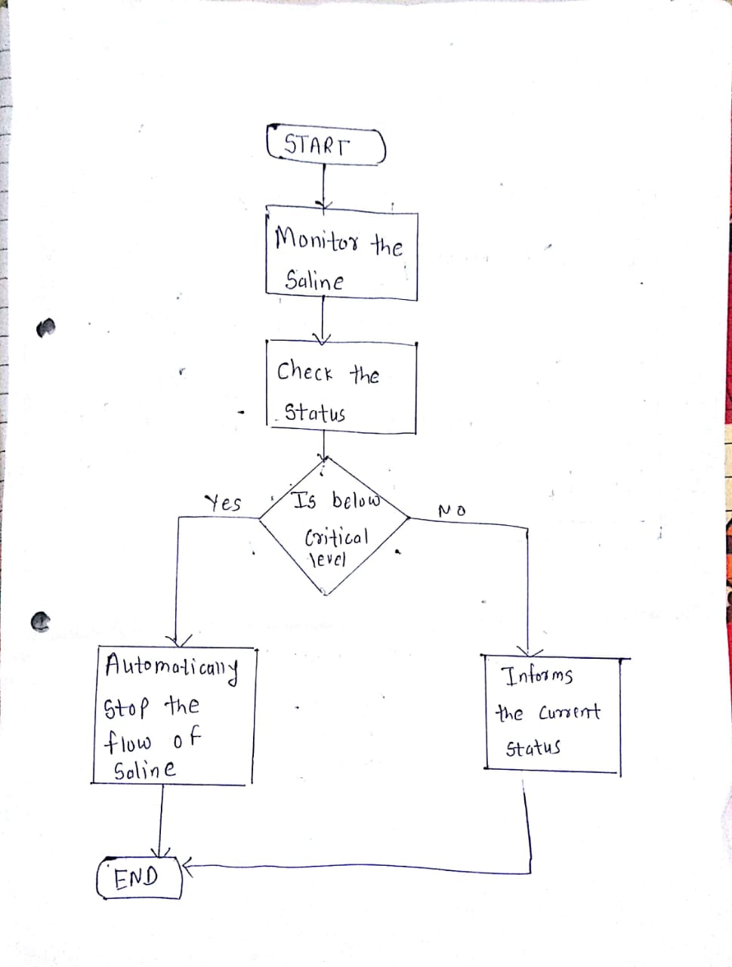
FlowChart

Slide 5
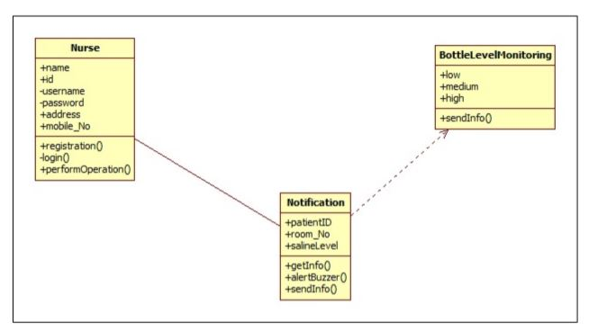
Class Diagram

Slide 6
High level Diagram

Slide 7
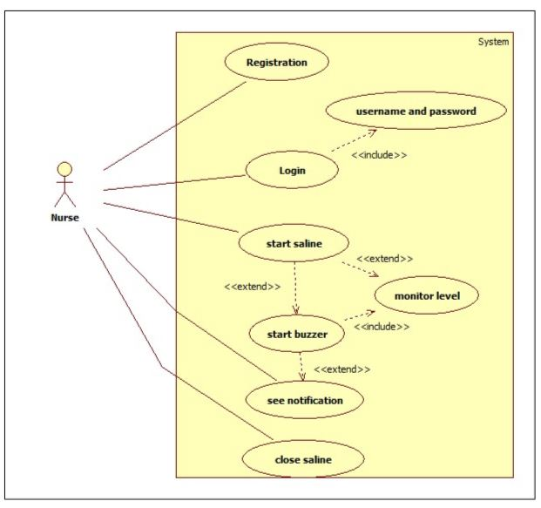
Usecase Diagram

Slide 8
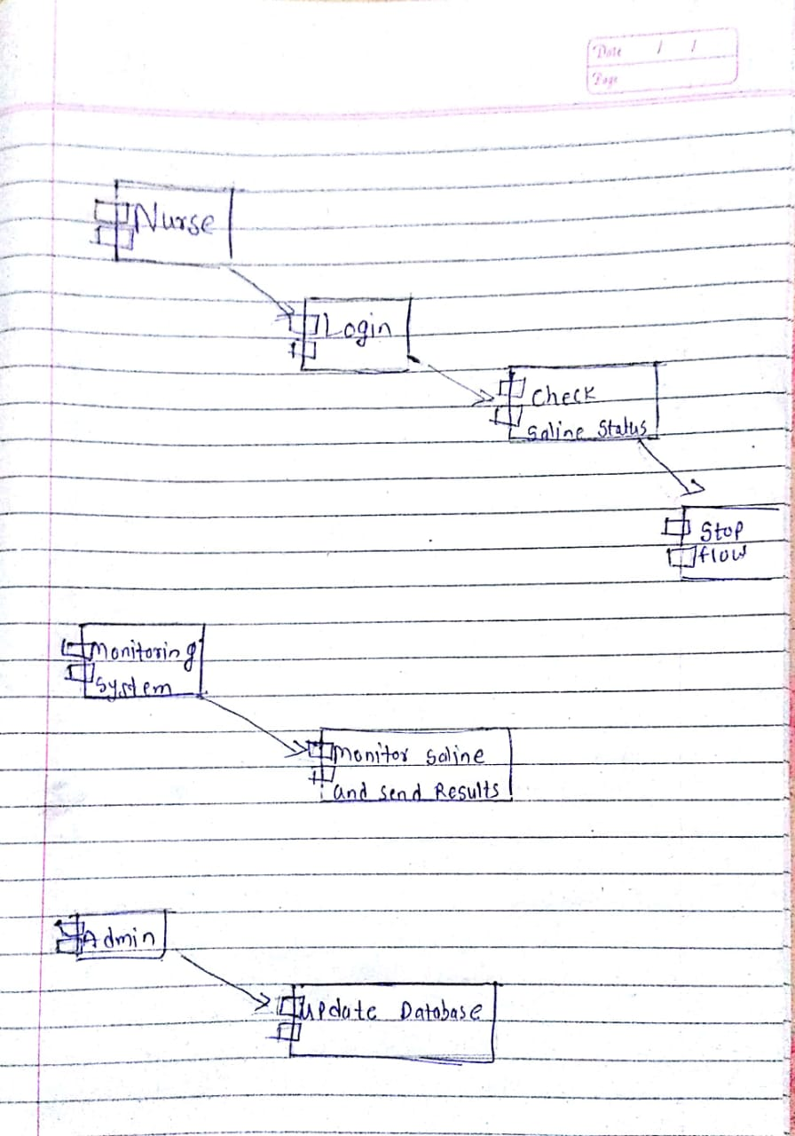
Component Diagram

Slide 9
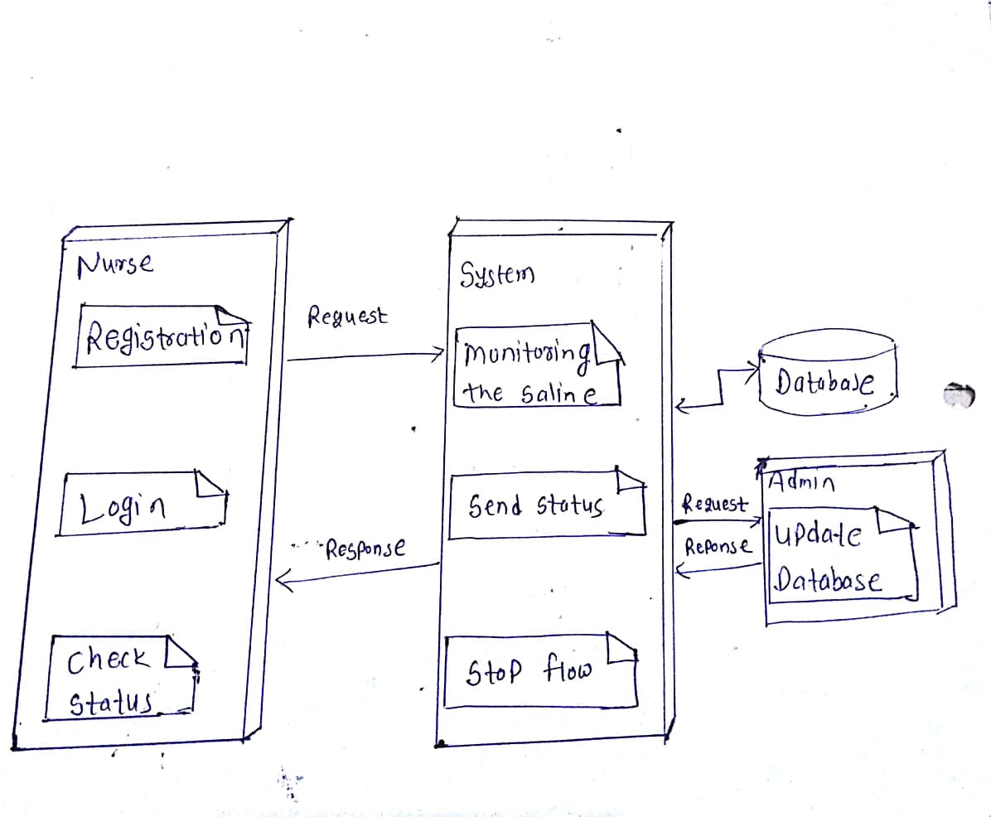
Deployment Diagram

